Slide 1

SYNTACTIC PARSING

Slide 2
PARSING TECHNIQUES
Constituency Parsing:
Identifies the syntactic constituents in a sentence and represents them hierarchically in a tree structure.
Dependency Parsing:
Focuses on the relationships between words, representing them as directed links between words.

Slide 3
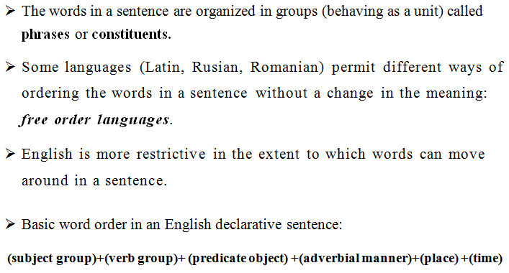
PHRASE STRUCTURE

Slide 4
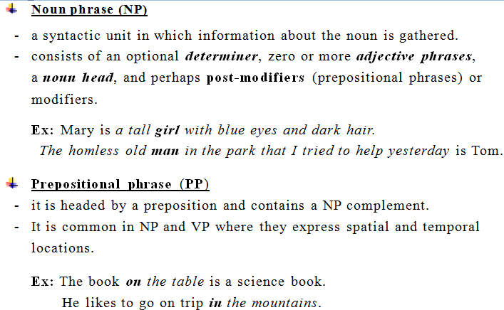
CONSTITUENTS (PHRASES)

Slide 5
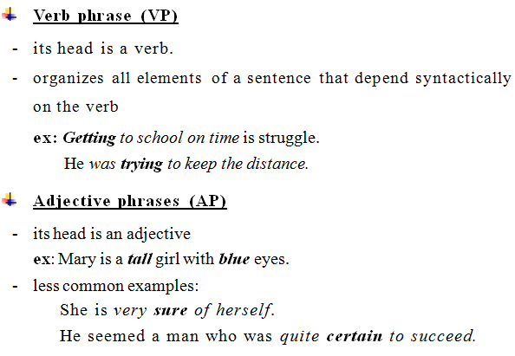
CONSTITUENTS (PHRASES)

Slide 6
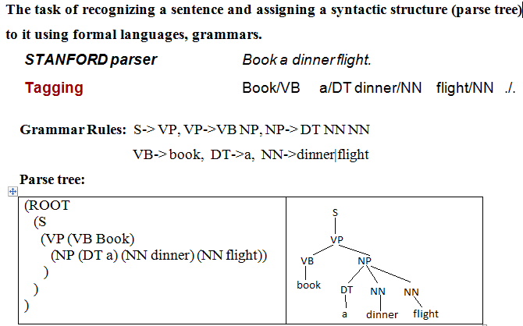
SYNTACTIC PARSING

Slide 7
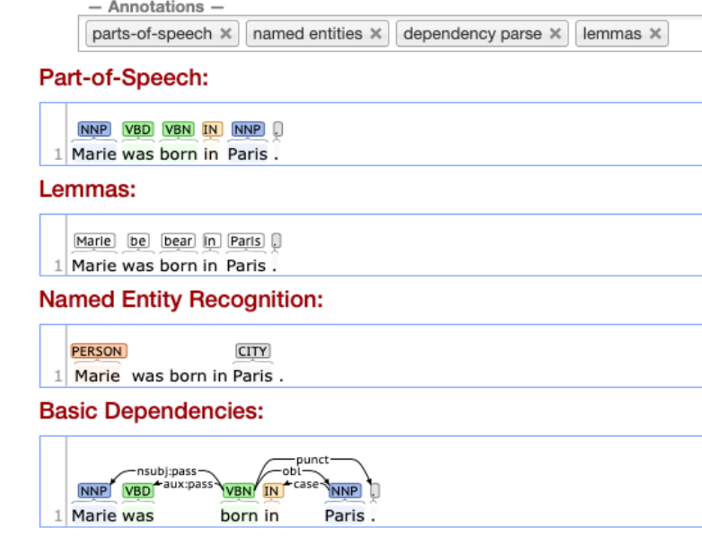
CORENLP

Slide 8
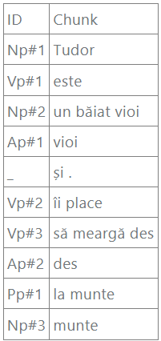
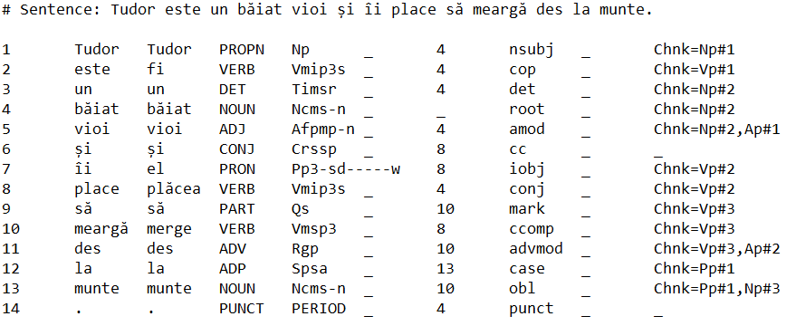
ROMANIAN – PHRASES – SHALLOW PARSING using RELATE - TEPROLIN
Tudor este un băiat vioi și îi place să meargă des la munte.

Slide 9
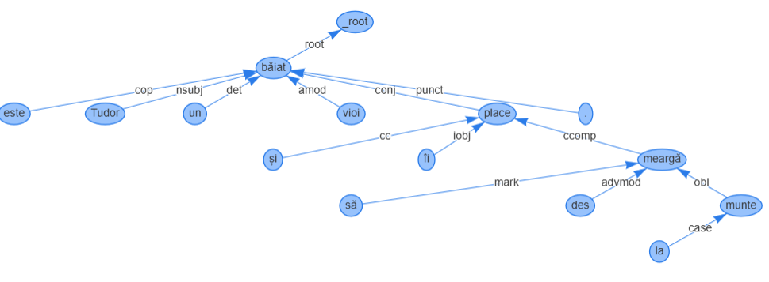
DEPENDENCY PARSING
USING RELATE - TEPROLIN
Tudor este un băiat vioi și îi place să meargă des la munte.

Slide 10
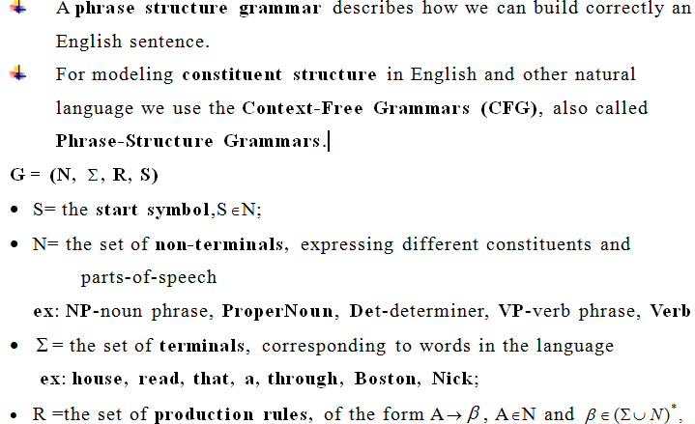
PHRASE STRUCTURE GRAMMAR (PSG)

Slide 11
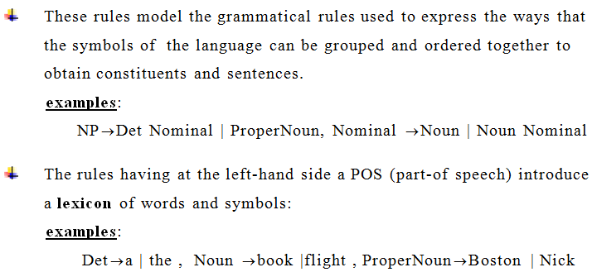
PRODUCTION RULES

Slide 12
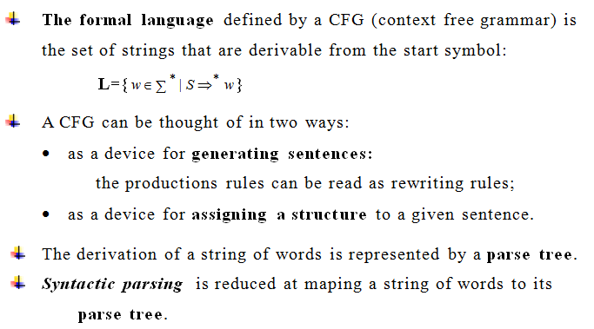

Slide 13
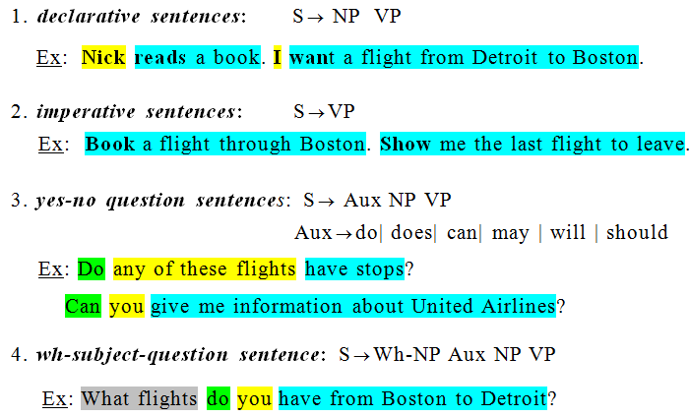
GRAMMAR RULES FOR ENGLISH
- SENTENCE LEVEL CONSTRUCTION

Slide 14
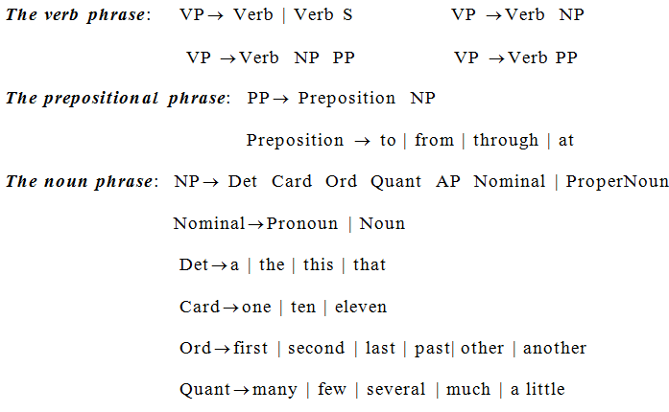
RULES FOR PHRASES (CONSTITUENTS)

Slide 15
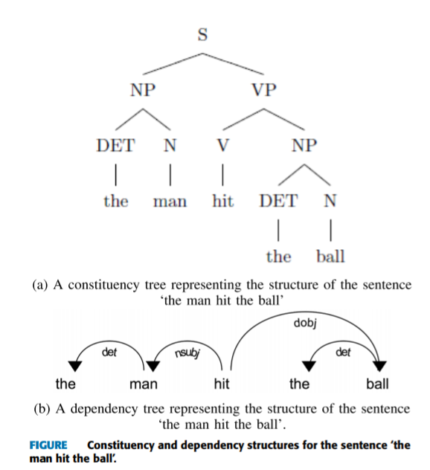
EXAMPLE

Slide 16
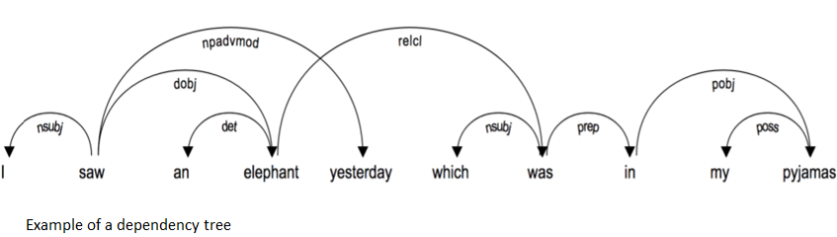
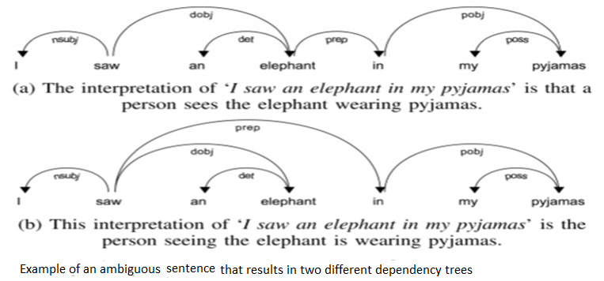
EXAMPLES

Slide 17
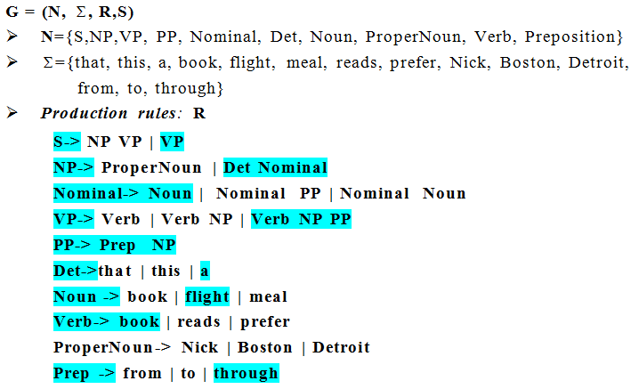
PSG IN ATIS (AIR TRAFFIC INTERNATIONAL SYSTEM)

Slide 18
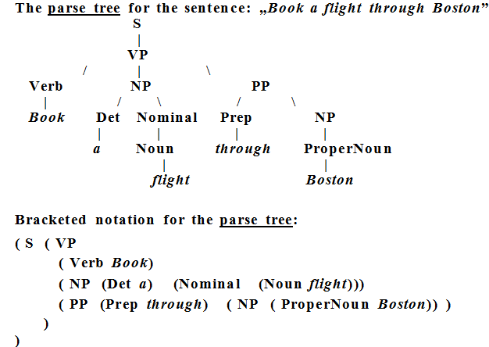
SYNTACTIC PARSING

Slide 19
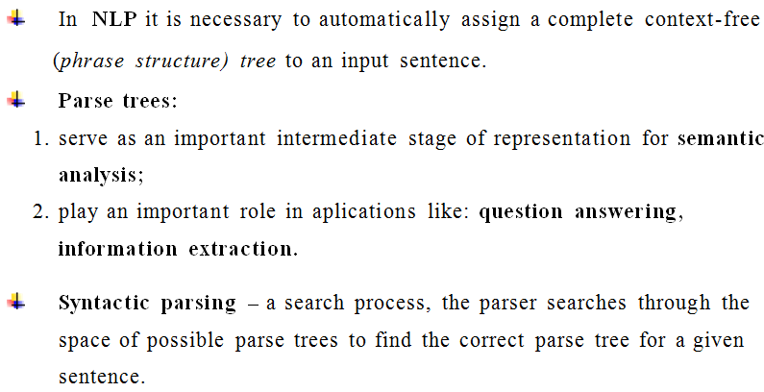
SYNTACTIC PARSING IN NLP

Slide 20
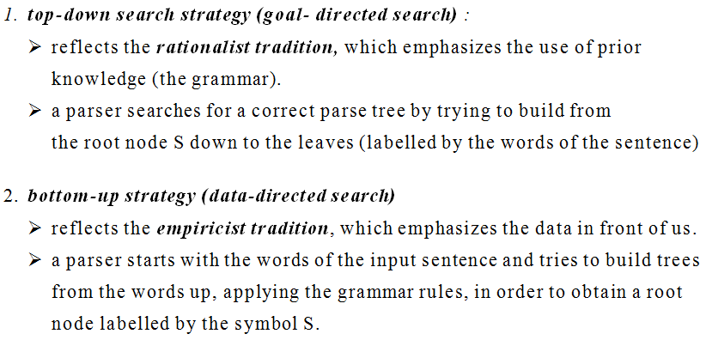
SYNTACTIC PARSING - STRATEGIES

Slide 21
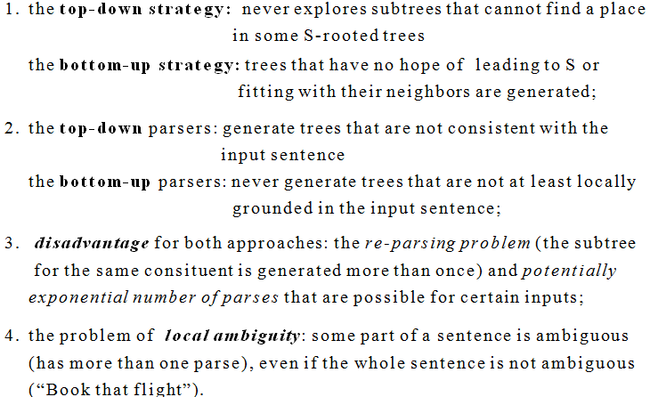
TOP-DOWN VERSUS BOTTOM-UP PARSING

Slide 22
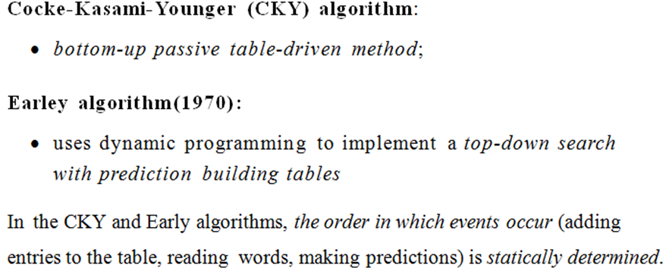
PARSING ALGORITHMS

Slide 23
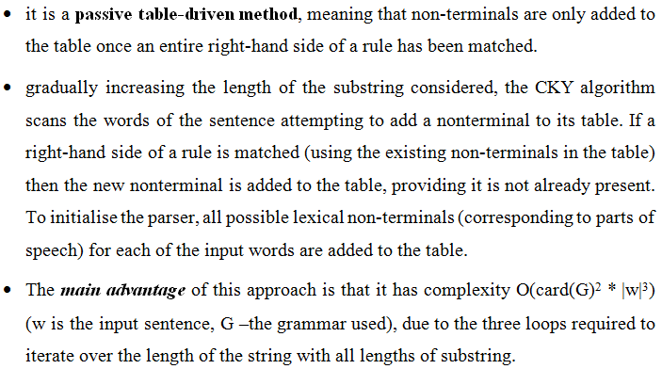
COCKE-KASAMI-YOUNGER (CKY) ALGORITHM

Slide 24
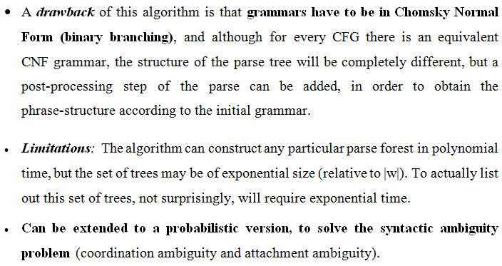
CKY ALGORITHM (CONTD.)

Slide 25
ATTACHMENT AMBIGUITY
It arises from uncertainty of attaching a phrase or clause to a part of sentence.
It usually happens when a sentence has more than two prepositional phrases.
Example 1
In the sentence “the boy saw the girl with the telescope”, the uncertainty is about relating the prepositional phrase “with the telescope” to “the boy” or to “the girl”.
This could end up with the following meaning based on the attachment;
1. The boy saw the girl carrying a telescope.
2. The boy saw the girl through the telescope
The first meaning arises if we attach the prepositional phrase with “the girl” whereas the second one arises if we attach the prepositional phrase with “the boy”.

Slide 26
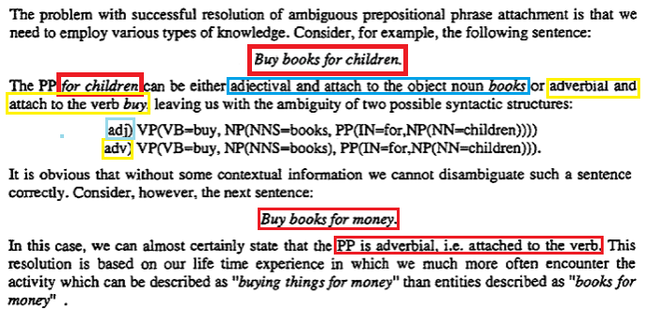
ATTACHMENT AMBIGUITY - EXAMPLES

Slide 27
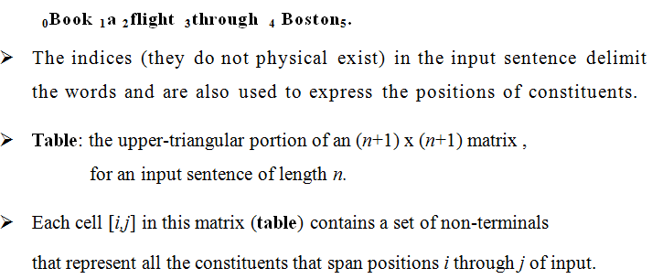
CKY ALGORITHM - INTERNAL DATA STRUCTURE

Slide 28
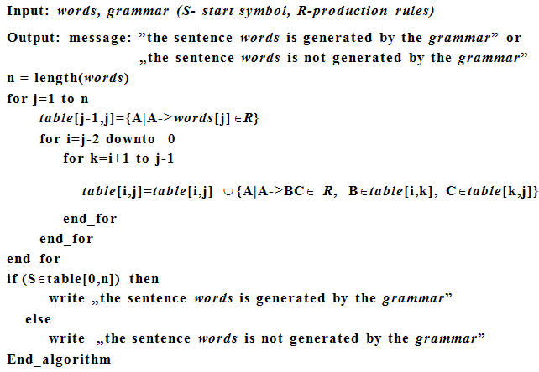
COCKE-KASAMI-YOUNGER (CKY) ALGORITHM

Slide 29
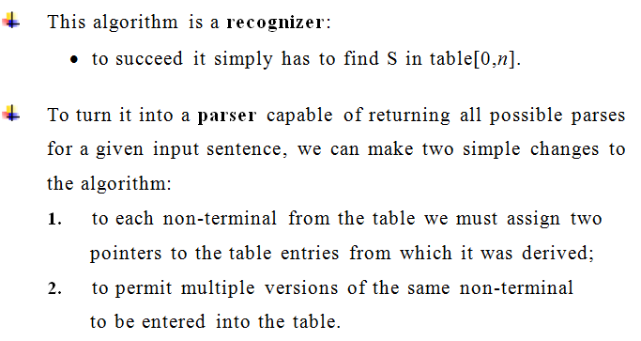
CKY ALGORITHM (CONTD.)

Slide 30
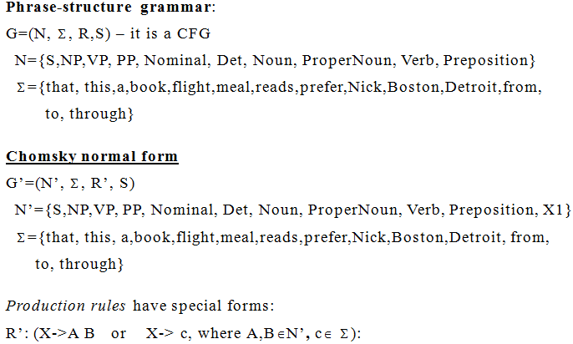
EXAMPLE 1

Slide 31
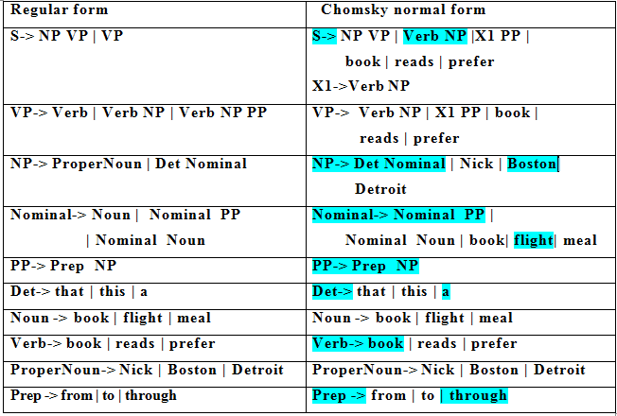

Slide 32
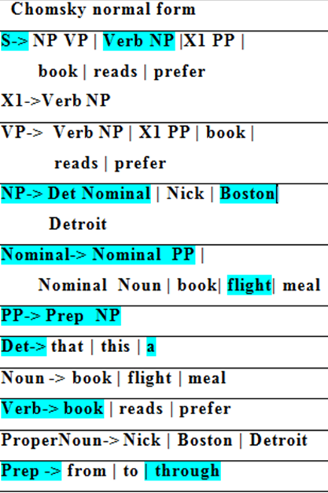
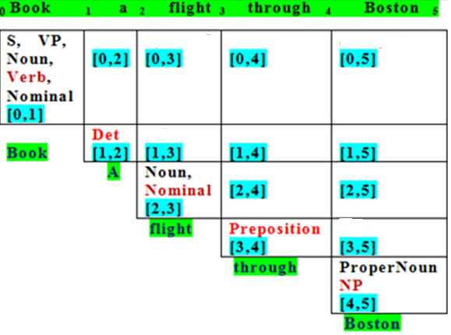
CKY PARSE TABLE FOR THE SENTENCE
BOOK A FLIGHT THROUGH BOSTON.

Slide 33
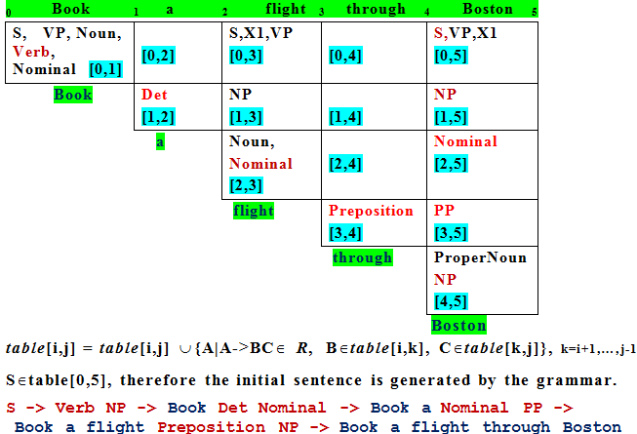
CKY PARSE TABLE FOR THE SENTENCE:
BOOK A FLIGHT THROUGH BOSTON.

Slide 34
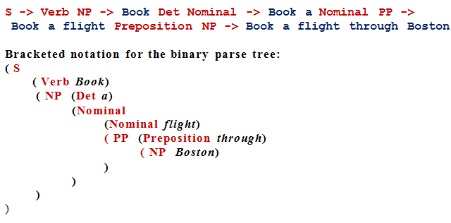
DERIVATION OF THE SENTENCE AND THE PARSE TREE

Slide 35
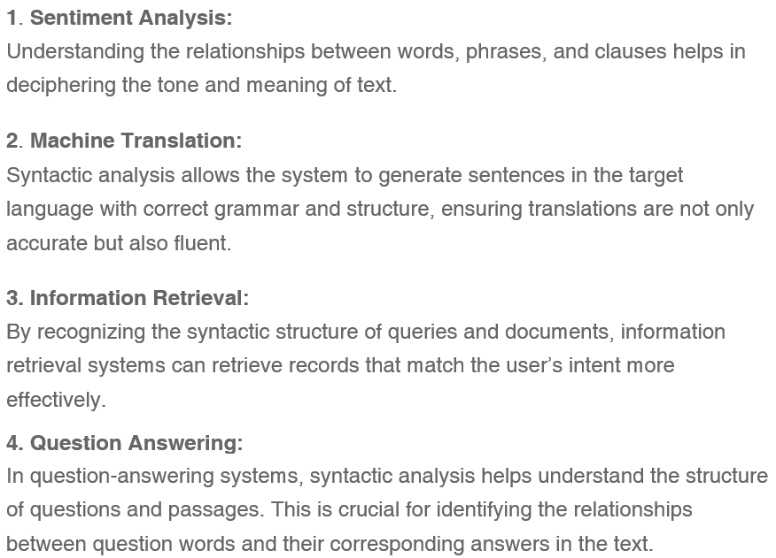
APPLICATIONS OF SYNTACTIC ANALYSIS

Slide 36
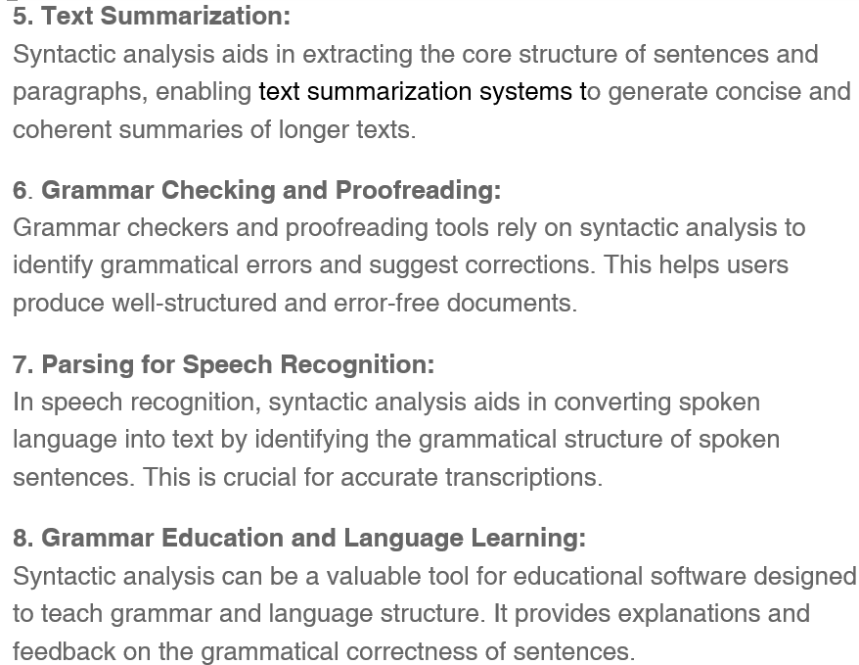
APPLICATIONS OF SYNTACTIC ANALYSIS

